Slide 1
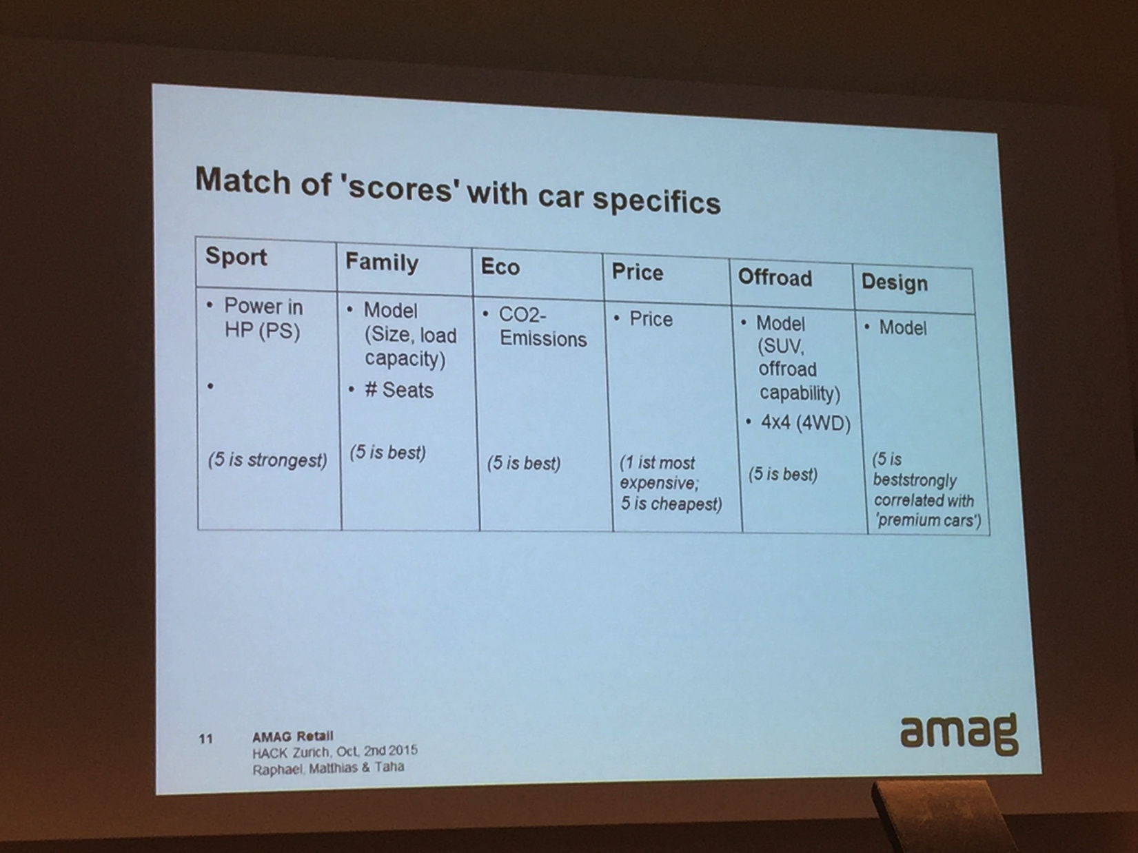





#CarHunters
Lorenz Hänggi (Mobile)“Team Leader”
Cedric Wider (Mobile)
Nawar El Husseini
(marketing, data analysis)
a cool App powered by
“HuntingCars“
2nd - 4th October 2015, 40h

Slide 2
Mission
Develop a cool, transparent & user friendly iOS App (in 40 hrs) which guides you to your dream car by hunting just the right ones based on who you are

Slide 3
What is the main idea?

Slide 4
Main idea
Searching for a car is too complex (too many fields) → we are looking for a simpler way
Search best scoring matches based on profile
Showing the TCO = Total Cost of Ownership to know what is the price / month (incl insurance, taxes, tires, rep, service, ...)
Find dealership of favorite cars using MapKit
Find car at dealership while location car using iBeacons (bluetooth enabled devices in car)

Slide 5

Deep dive: TCO
Total Cost of Ownership or True Cost to Own
Most of the customer can afford the car. But can they afford the running costs?
Taxes+fees, insurance, maintenance, repairs, financing, deprecation, fuel, tires
Customer experience while buying
Less personal dept
Potential for car-resellers to handle all
example

Slide 6
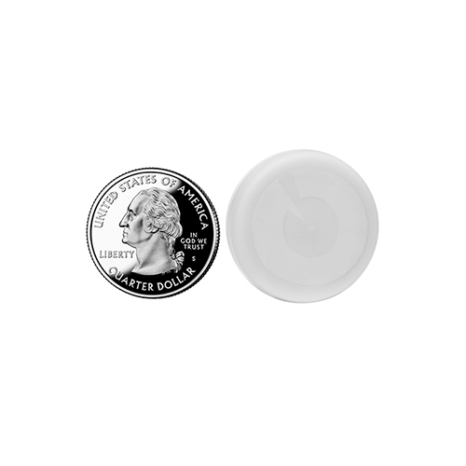
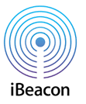
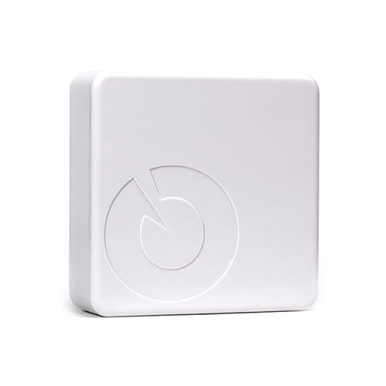
Deep dive: iBeacons
ibeacon: bluetooth enabled device that can be tracked with a Smartphone (distance, direction)
Bsp: roximity, ... > 100 devices and producer
Install in every car a configured ibeacon (VIN, amag-Id, ... stored in cloud)
Automatic process to manage devices and cloud-entries
Customer with App on Smartphone will be able to location the car, without a sales person
amag can track who was visiting which car to optimize car locations inside / outside shop
Ca 60m

Slide 7
What did we do?

Slide 8
Main idea and base
Based on amag API, searching via scoring (Workshop 7) presented by Raphael, Matthias and Taha
iOS App to use sensors (Map, Location, iBeacons)
Asking only a few simple but personal question to find the right cars
Search by scoring values, and sort them accordingly
Tinder cars (like, dislike)
Show details of car (attributes, TCO, dealer location, car location at dealership using ibeacons)

Slide 9
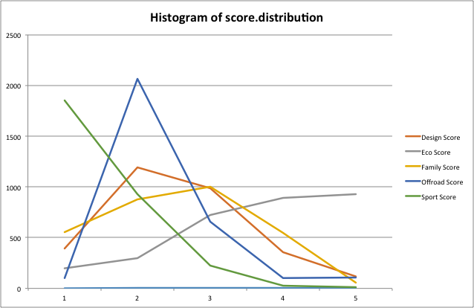
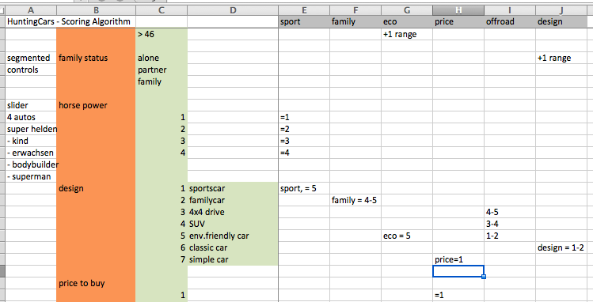
SCORES

Slide 10
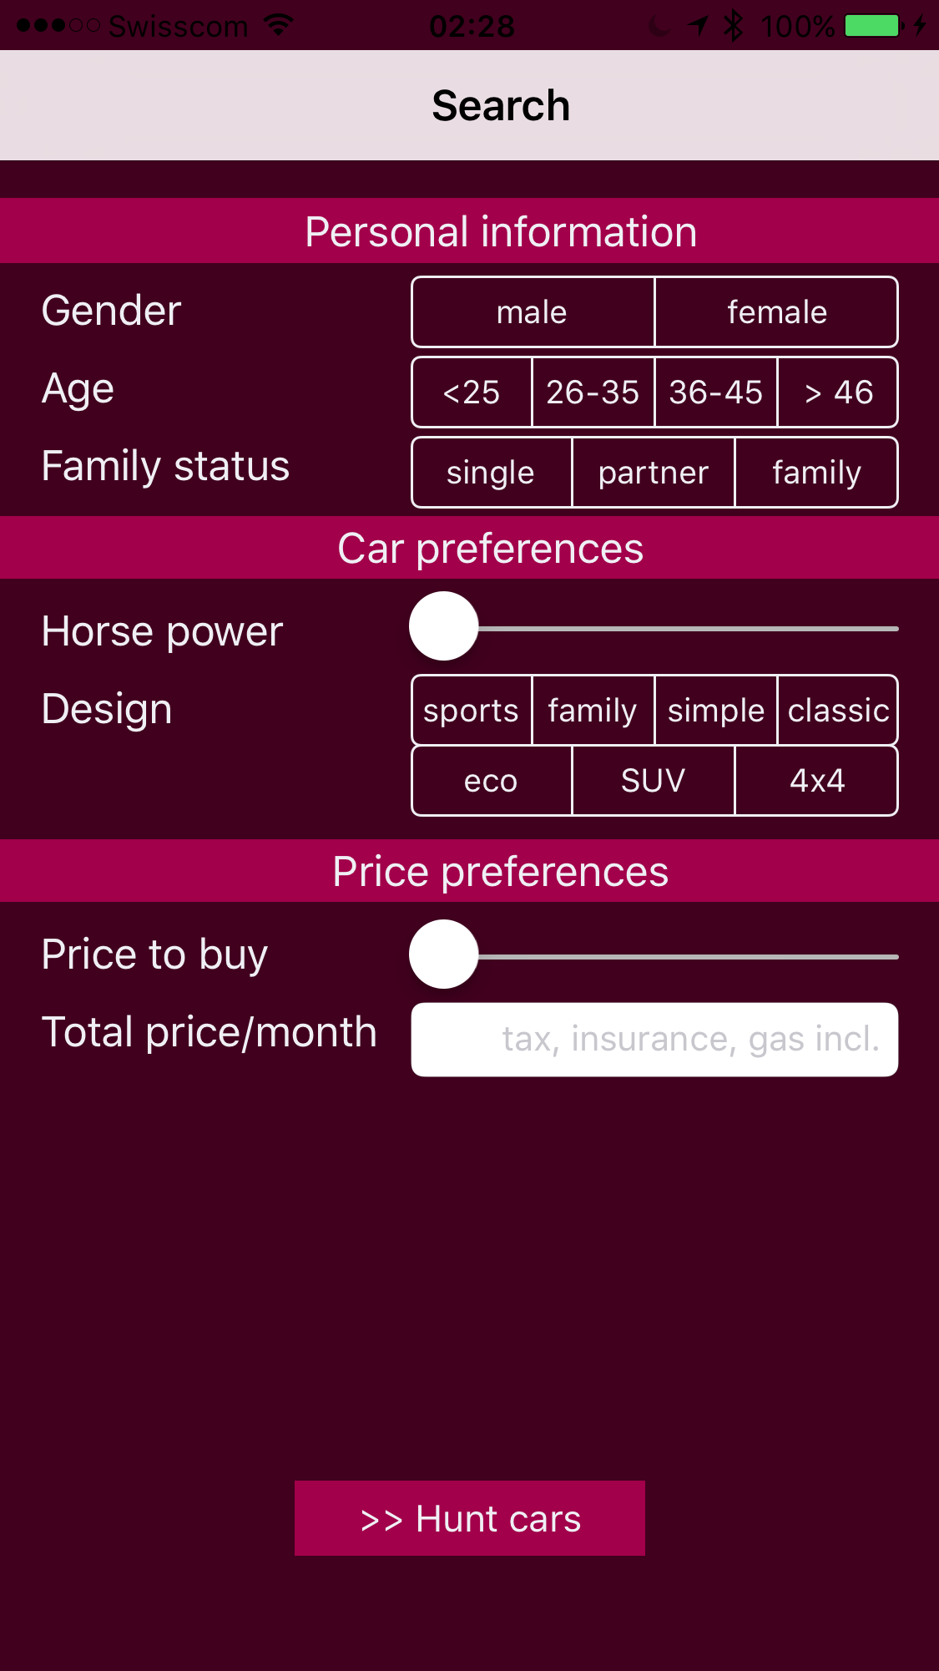
SEARCH- Fields →SCORES

Slide 11
Major Activities that were implemented:
Figure out which attributes are important to filter
Field study at hackZurich (> 15 people)
Make research of the API
Wire framing & navigation actions on high level
Determine which page is dynamic which is static
Design & code for all the details of every page
Implement a static clickable App
Make every page dynamic, bugfixing

Slide 12
What we achieved?
Demo

Slide 13
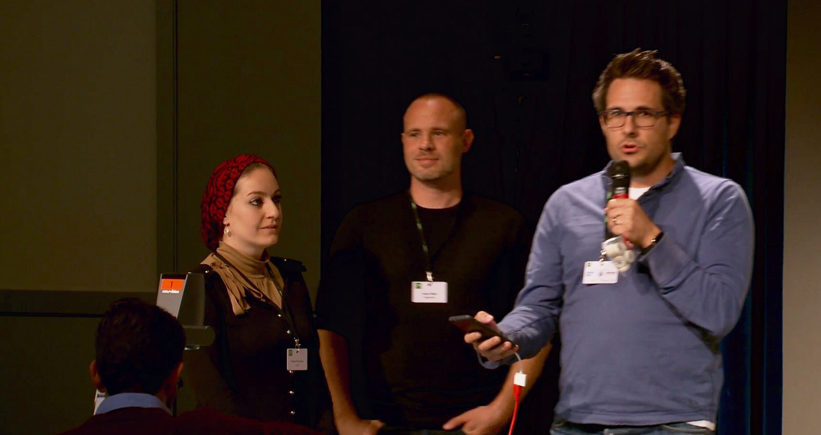
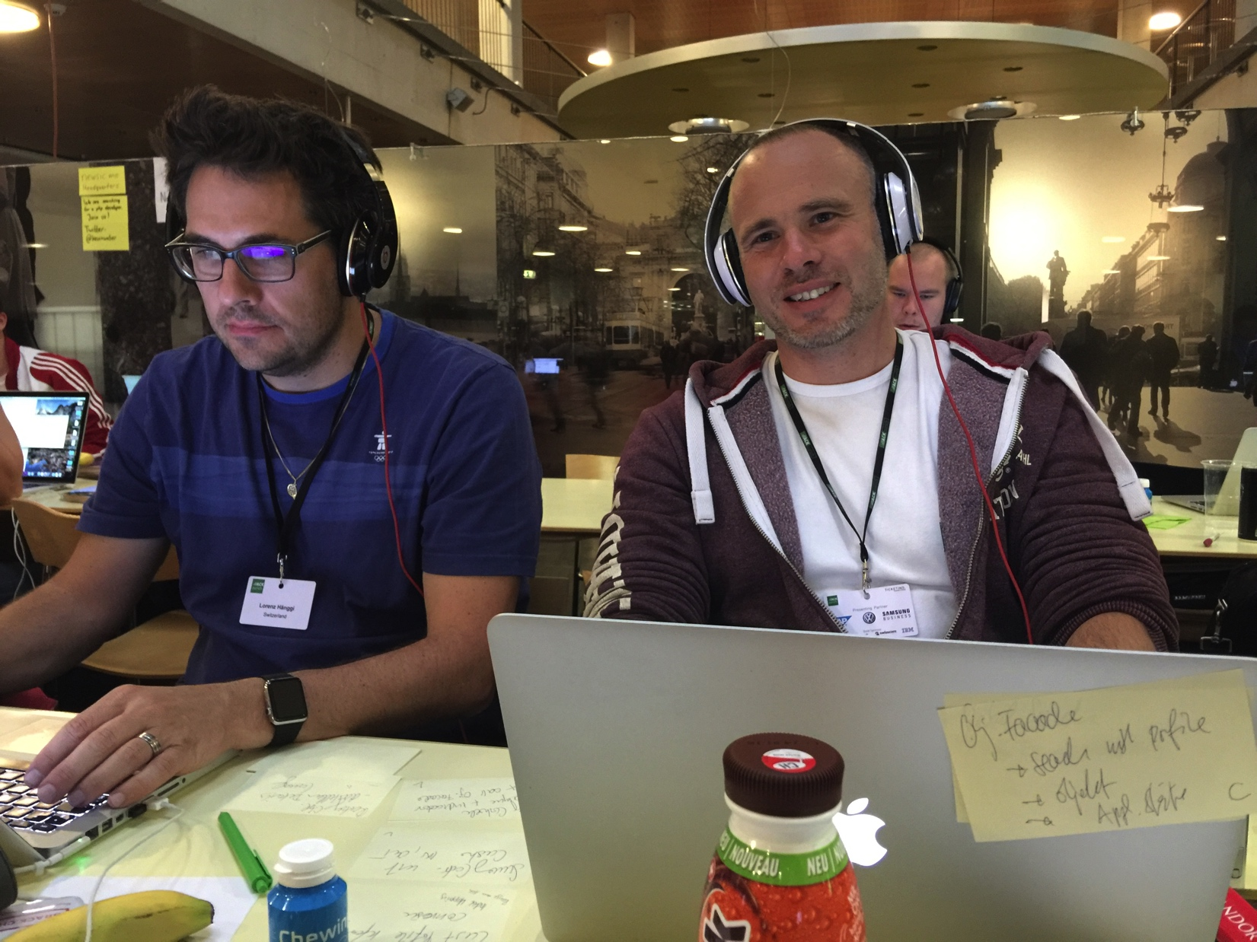
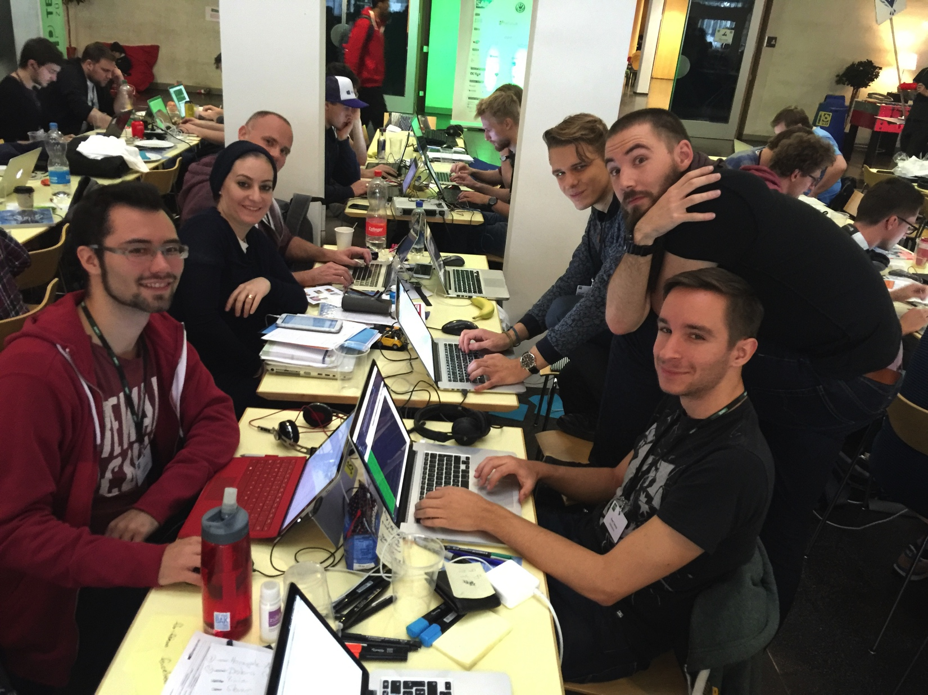
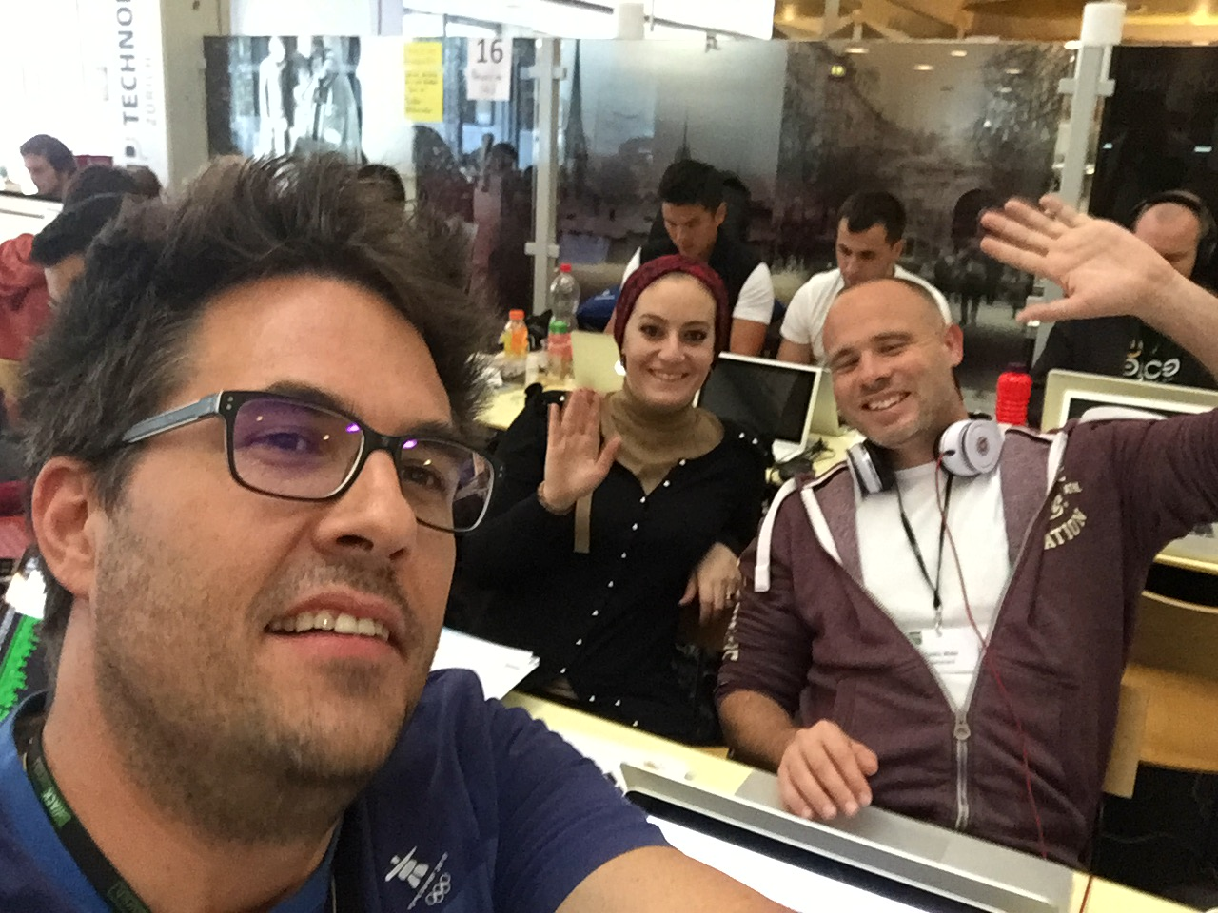
Among the best 25 ideas

Slide 14
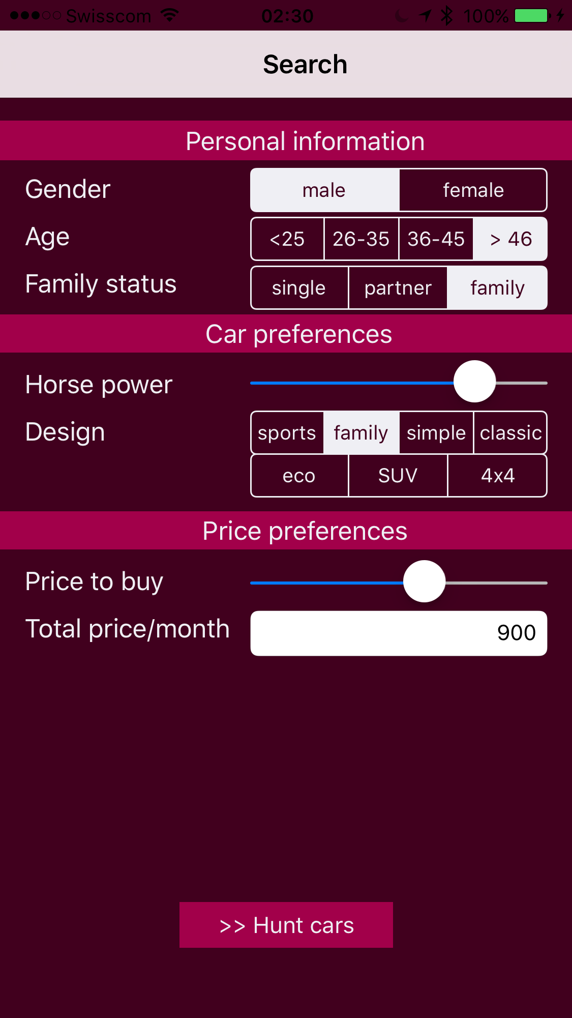

Slide 15
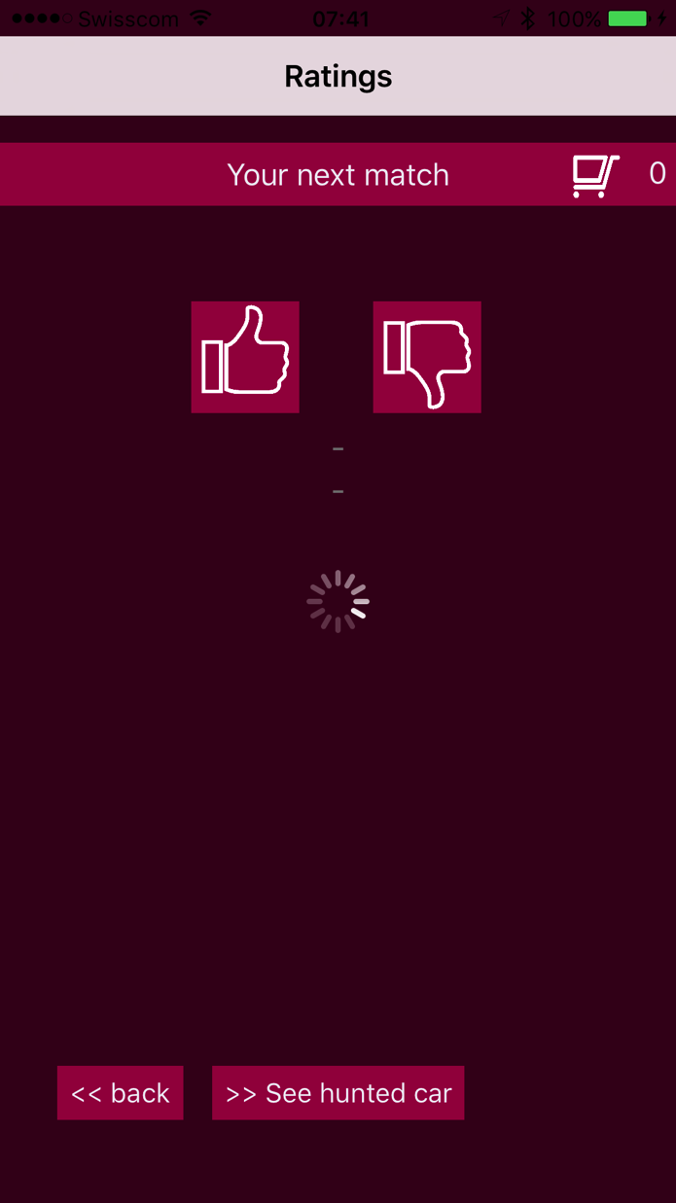
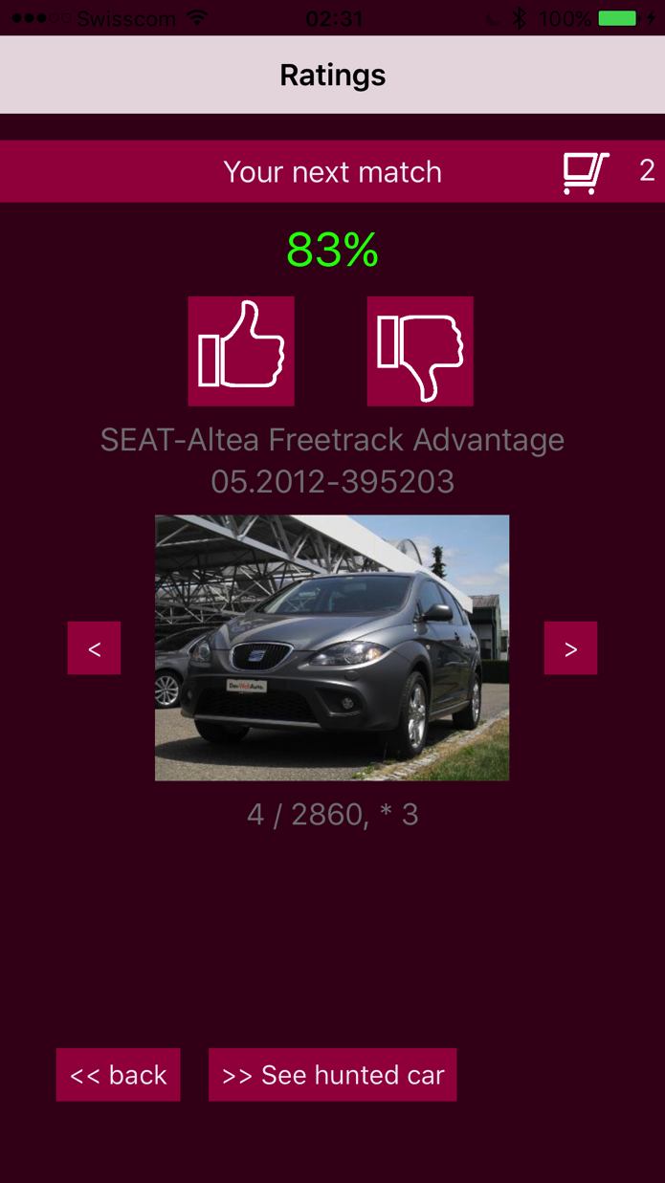

Slide 16
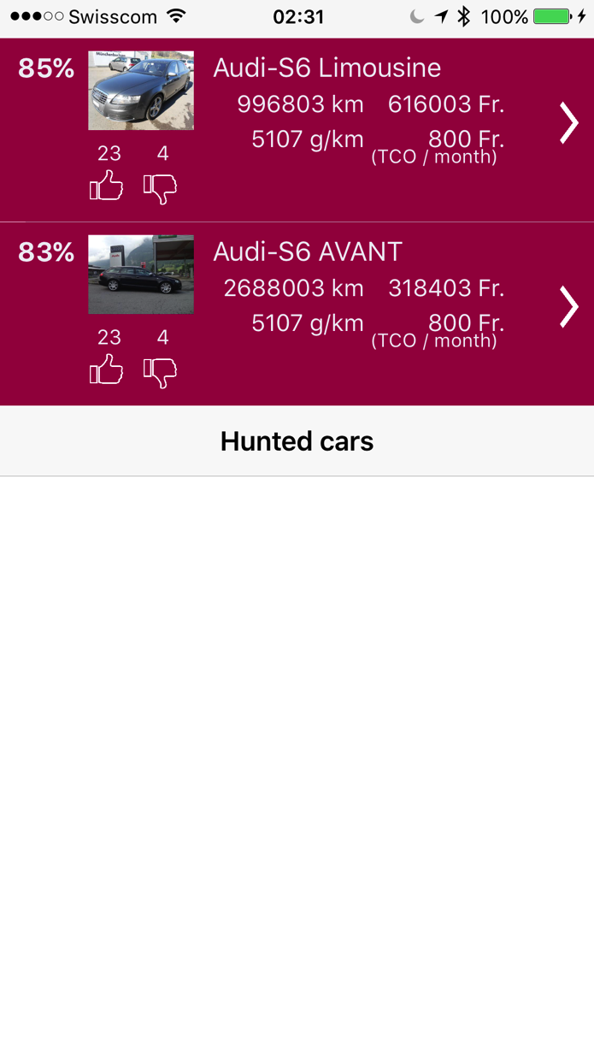

Slide 17
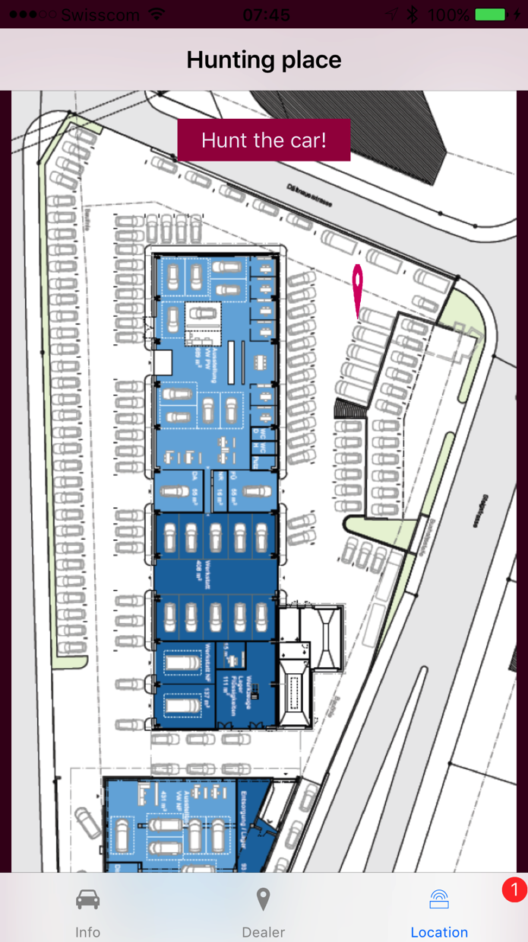
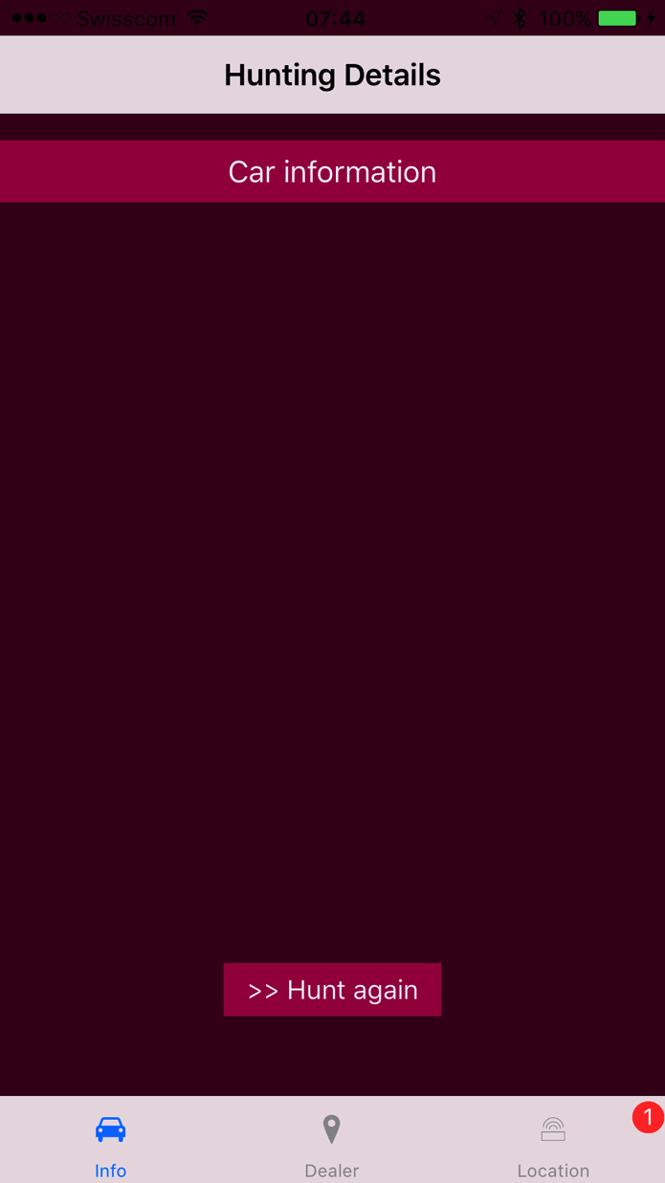
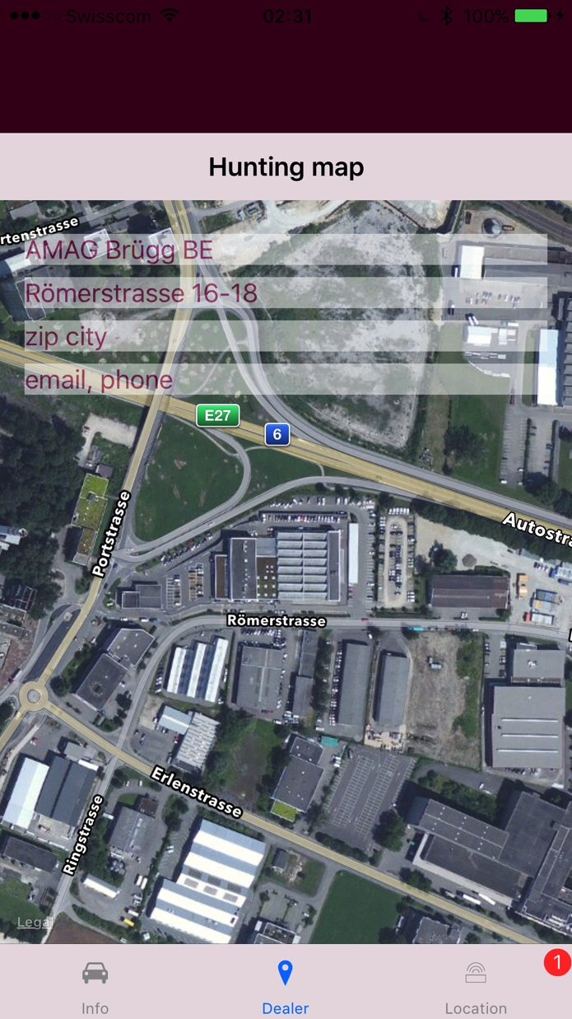

Slide 18
Thank you

